Slide 1



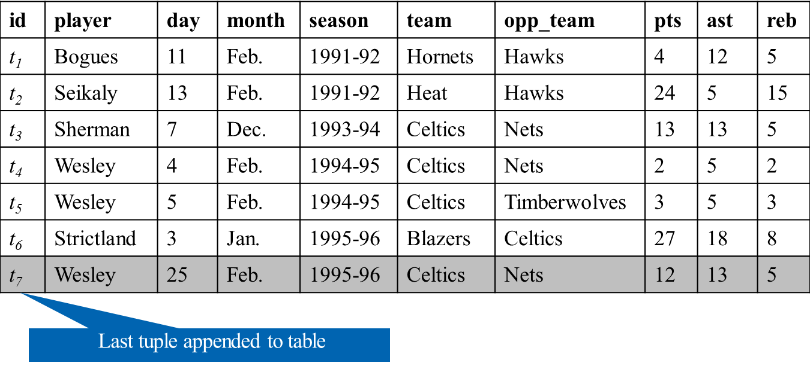
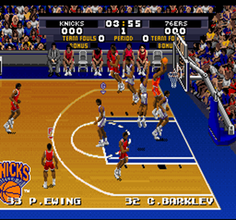
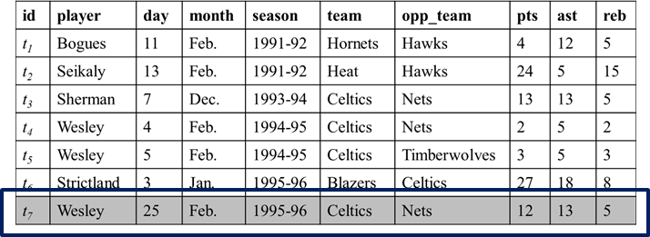
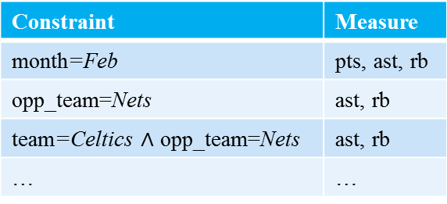
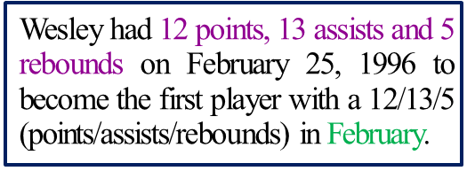
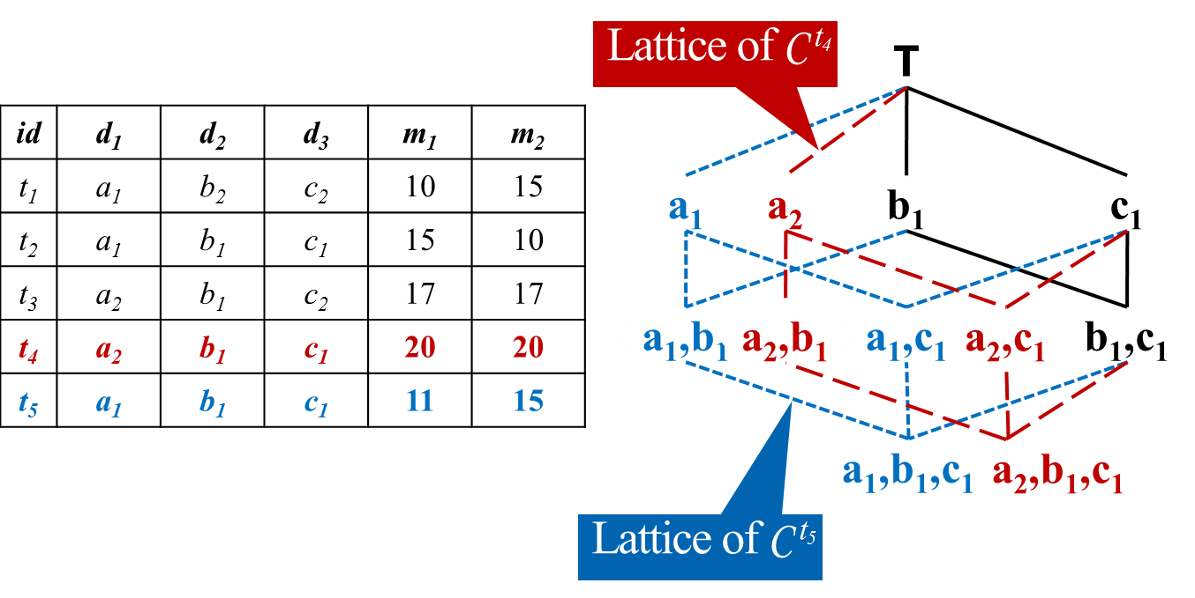
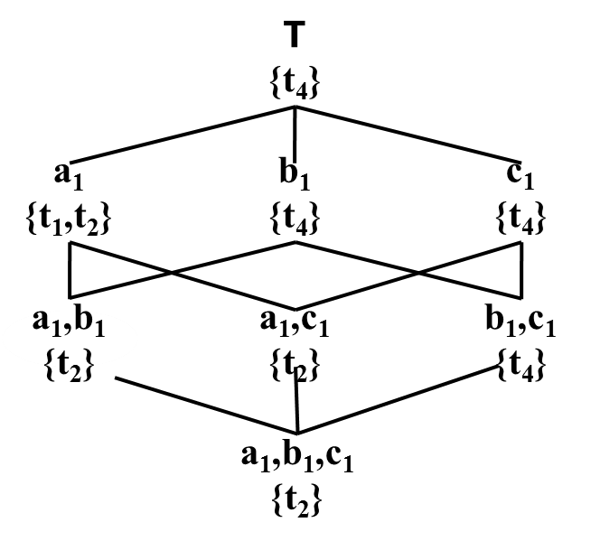
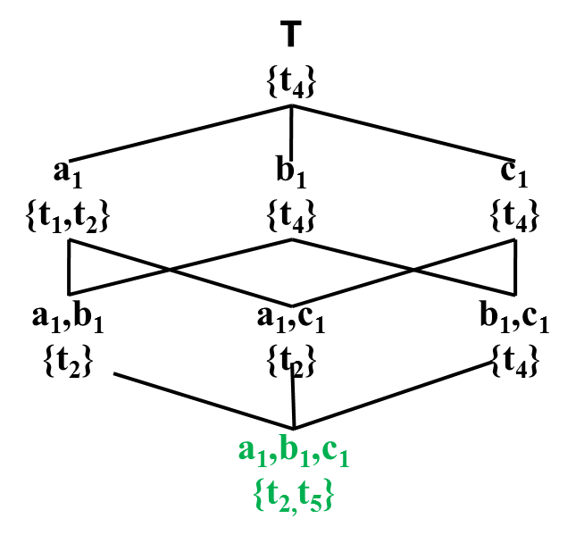
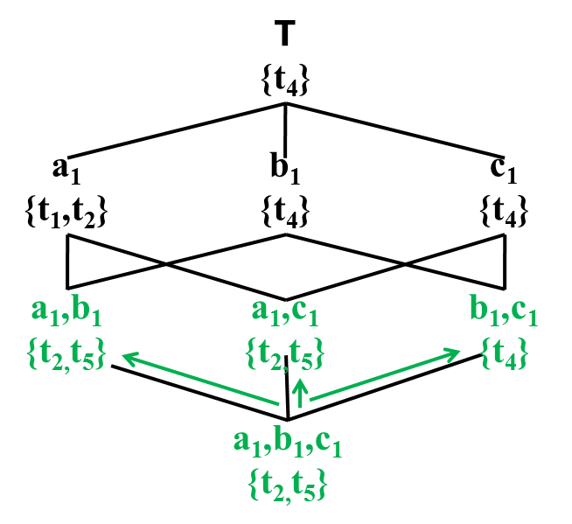
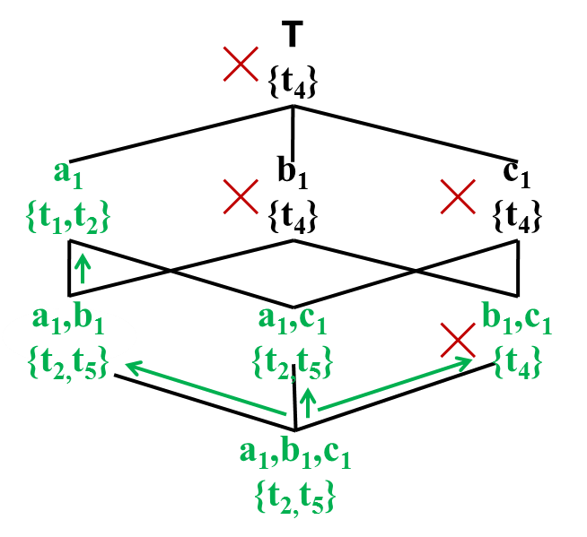


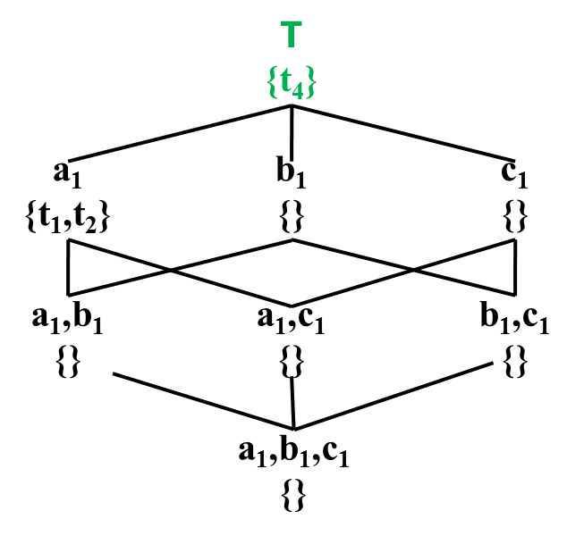
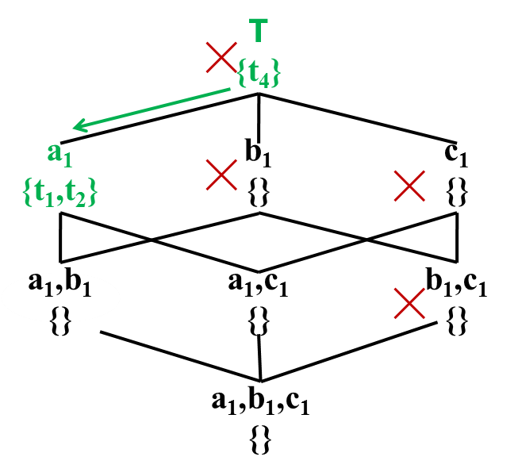
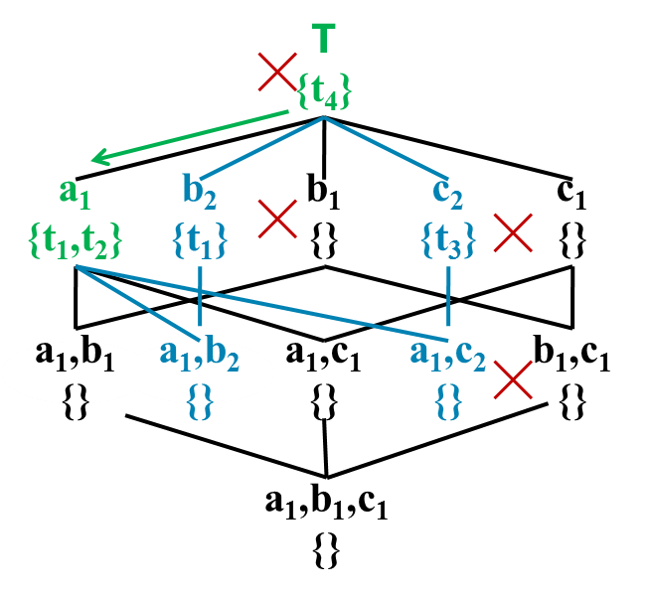
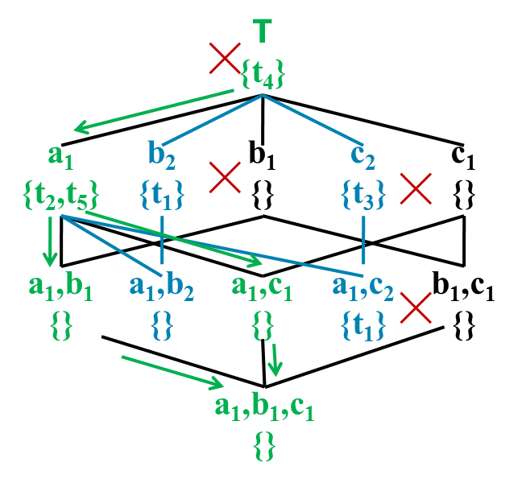
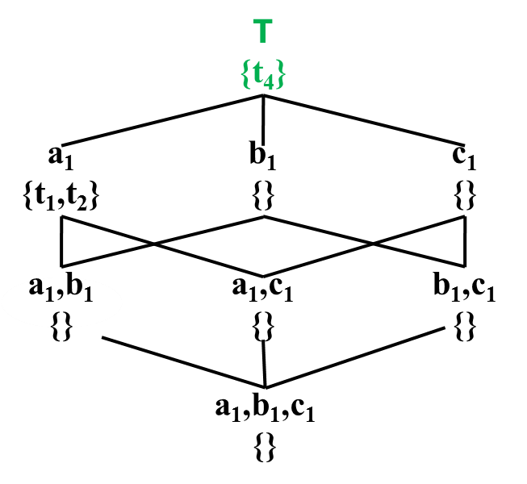
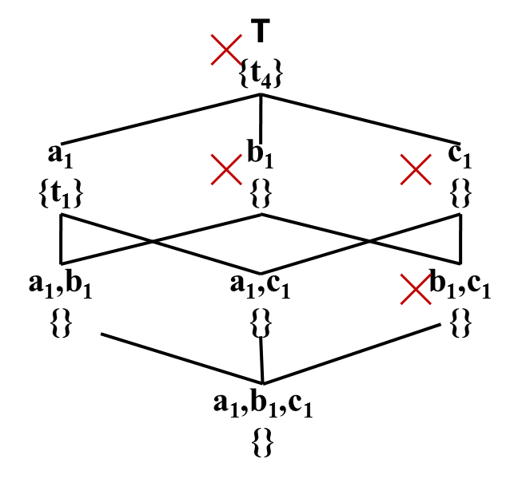
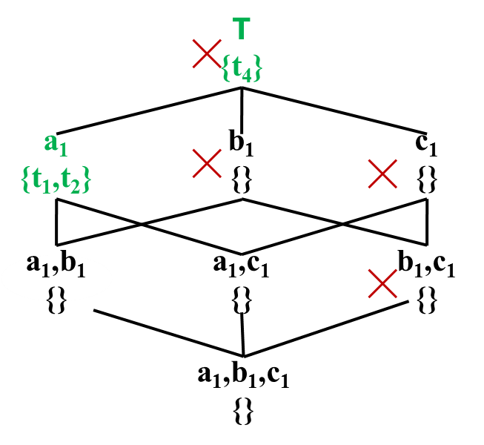
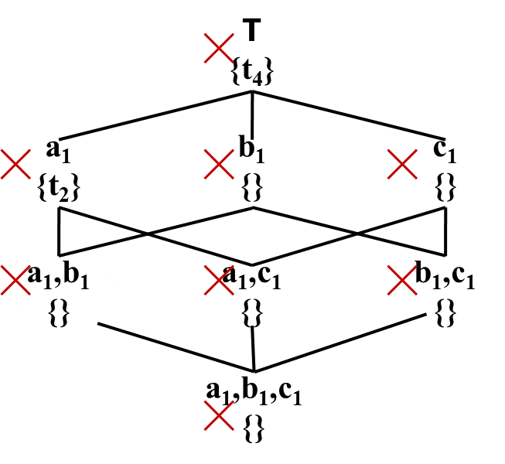
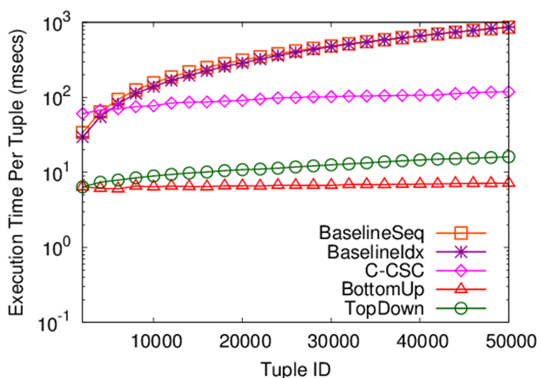
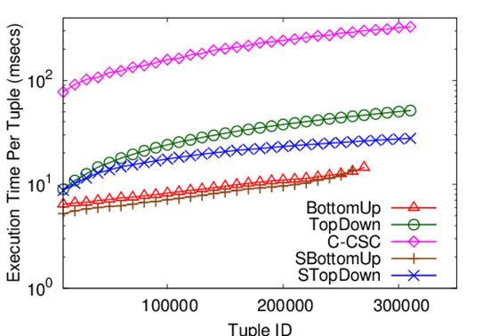
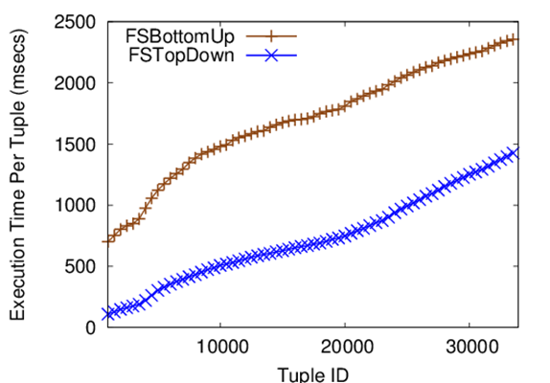
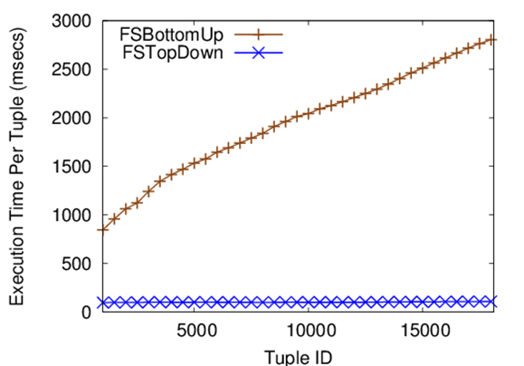


Incremental Discovery of Prominent Situational Fact
30th IEEE International Conference on Data Engineering, Chicago, IL, 2014
Afroza Sultana¹, Naeemul Hassan¹, Chengkai Li¹, Jun Yang², Cong Yu³
¹University of Texas at Arlington, ²Duke University, ³Google Research
Situational Facts
A Mini-world of Basketball Gamelogs
Sports: “Paul George had 21 points, 11 rebounds and 5 assists to become the first Pacers player with a 20/10/5 (points/rebounds/assists) game against the Bulls since Detlef Schrempf in December 1992.”
Social Media: “The social world’s most viral photo ever generated 3.5 million likes, 170,000 comments and 460,000 shares by Wednesday afternoon.”
Stock Data: Stock A becomes the first stock in history with price over $300 and market cap over $400 billion.
Weather Data: Today’s measures of wind speed and humidity are x and y, respectively. City B has never encountered such high wind speed and humidity in March.
Criminal Records: There were 50 DUI arrests and 20 collisions in city C yesterday, the first time in 2013.
Wesley had 12 points, 13 assists and 5 rebounds on February 25, 1996 to become the first player with a 12/13/5 (points/assists/rebounds) in February.
Wesley had 13 assists and 5 rebounds on February 25, 1996 to become the second Celtics player with a 13/5 (assists/rebounds) game against the Nets.
Problem Definition
Constraint (C): d₁=v₁∧d₂=v₂∧…∧d_{n}=v_{n},v_{i}∈dom(d_{i})∪{∗}
team=Celtics ∧ opp_team=Nets
Constraint-Measure Pair (C, M): Combination of a constraint and measure subspace
(team=Celtics ∧ opp_team=Nets,{assists,rebounds})
Contextual skyline: skyline regarding (C, M)
σ_{team=Celtics ∧ opp_team=Nets}(R), M={assists,rebounds}
{t₃}
Tuples capturing real world events appended to table
Find constraint-measure pair (C,M) such that t is in the contextual skyline.
Template
Related Work
Modeling
Challenges and Ideas
Conventional skyline analysis
(Borzsonyi et al. ICDE 2001)
Given question, find answer
Compressed Skycube
(Xia et al. SIGMOD 2006)
Update compressed skycube in monitoring fashion
Prominent Analysis by Ranking
(Wu et. Al. VLDB 2009)
Static data, onetime query
Find the contexts where an object is ranked high in a single scoring attribute
Exhaustive comparison with every tuple
Tuple reduction
t₄≻_{{m1,m2}}t₃≻_{{m1,m2}}t₅ => t₄≻_{{m1,m2}}t₅
Comparison with skyline tuples are enough
Tuple Satisfied Constraint C ^{t} : If ∀d_{i}∈D, C.d_{i}=∗ or C.d_{i}=t.d_{i}, t satisfies C.
Under every constraint
Constraint pruning
In C ^{t,t'}, one comparison on t and t' is enough
Lattice Intersection: C ^{t4,t5}=C ^{t4}∩C ^{t5}
Over every measure subspace
Sharing computation across measure subspaces
Reusing computations on full space in subspaces
Algorithm BottomUp
Stores a tuple for every such constraint that qualifies it as a contextual skyline tuple
Traverses the constraints in C ^{t} in a bottom-up, breadth-first manner
Total 6 comparisons in this scenario
Algorithm TopDown
Skyline Constraints: Constraints whose contextual skylines include t.
Maximal Skyline Constraints: Constraints not subsumed by any other skyline constraints of t.
Total 3 comparisons in this scenario
Algorithm STopDown
Experiment Setup
Computation over full space is enough in finding skyline constraints in subspaces.
NBA Dataset
317,371 tuples of NBA box scores from 1991-2004 seasons
8 dimension and 7 measure attributes
Weather Dataset
7.8 million tuples of weather forecast from different locations of six countries & regions of UK
7 dimension and 7 measure attributes
Skips 3 comparisons
{m₂}
{m₁}
{m₁, m₂}
{m₁, m₂}
Memory-Based Implementation
File-Based Implementation
Discovered Facts
Lamar Odom had 30 points, 19 rebounds and 11 assists on March 6, 2004. No one before had a better or equal performance in NBA history.
Allen Iverson had 38 points and 16 assists on April 14, 2004 to become the first player with a 38/16 (points/assists) game in the 2004-2005 season.
Damon Stoudamire scored 54 points on January 14, 2005. It is the highest score in history made by any Trail Blazers.
NBA Dataset
NBA Dataset
NBA Dataset
Weather Dataset

